Slide 1
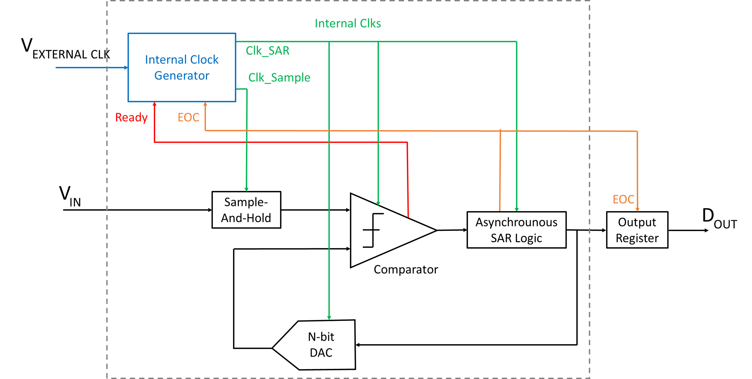
10bit low power ADC using SAR Architecture and dynamic comparator
M . Phanindra
P.V Srinivas
K. Hemanth

Slide 2
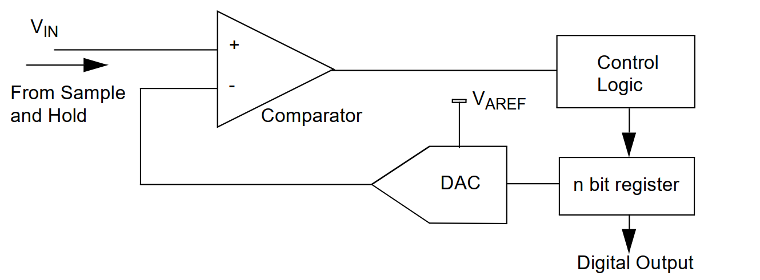
SAR architecture:

Slide 3
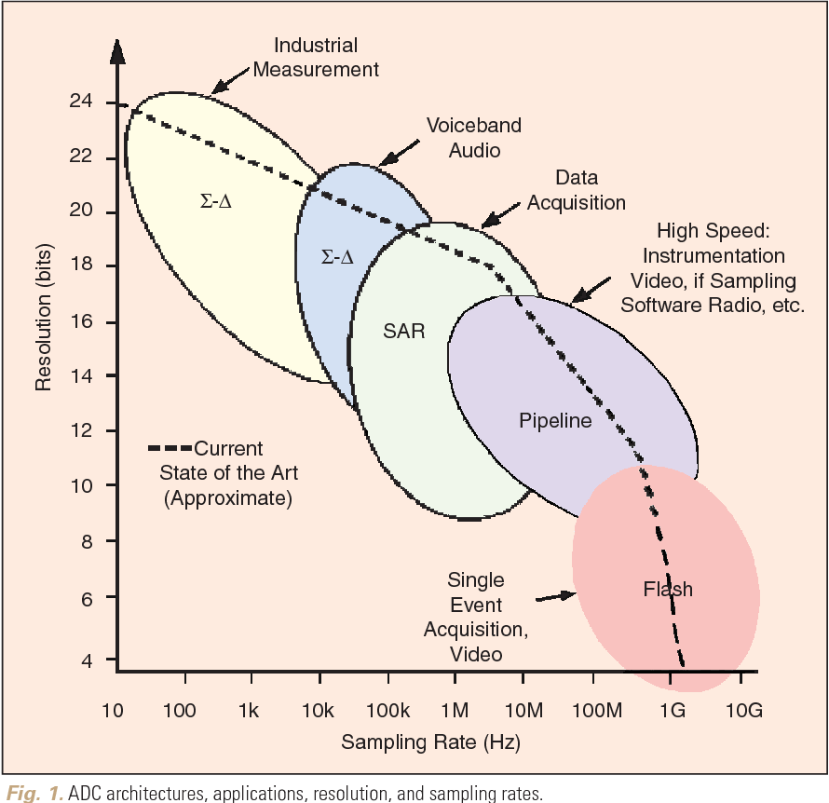
Types and Differences

Slide 4
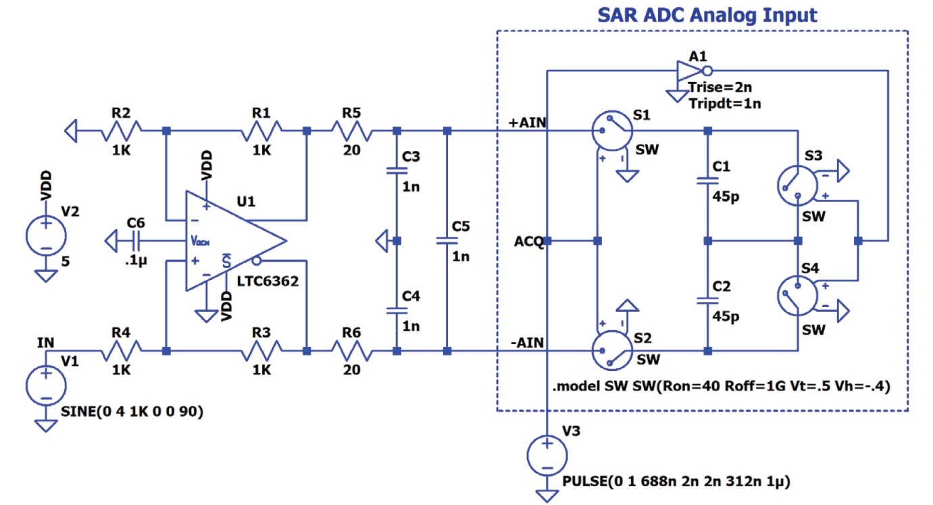
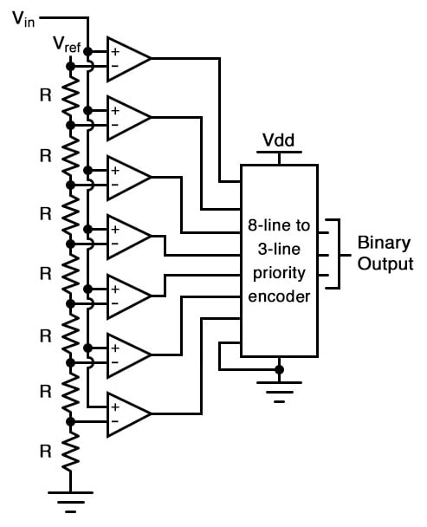
Differences :
 | Flash ADC | SAR ADC
Power consumption | Consume significant power due to their parallel structure. | Generally efficient with medium to low power consumption.
Speed | flash ADCs are the fastest, at the cost of resolution. | Providing medium speed, SAR ADCs strike a balance between conversion speed and resolution.
Resolution | low to medium resolution. | Medium to high resolution, this makes them more versatile and adaptable to various applications.
Complexity | Considered complex due to the need for numerous comparators. | Moderately complex in nature.

Slide 5
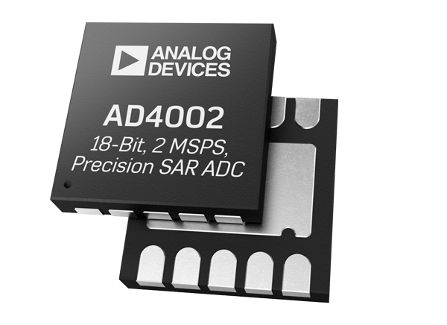
Why SAR ADC ?
The most commonly used type of analog-to-digital converter in digital voltmeters is the successive approximation ADC. This type of ADC is popular for its relatively high speed and accuracy, making it well-suited for digital voltmeter applications.
In a multitude of applications ranging from sensor data acquisition to audio processing, there is often no pressing requirement for ultra-high-speed conversions. In such contexts, the SAR ADC emerges as an exemplary solution
The capacity of SAR ADCs to conduct conversions with fewer transistors and diminished capacitance compared to parallel architectures, such as Flash ADCs, assumes pivotal importance in curtailing power consumption
Some widely used ADC IC’s using SAR Architecture are AD400X series from analog devices, and
ADS795X series from TI.

Slide 6
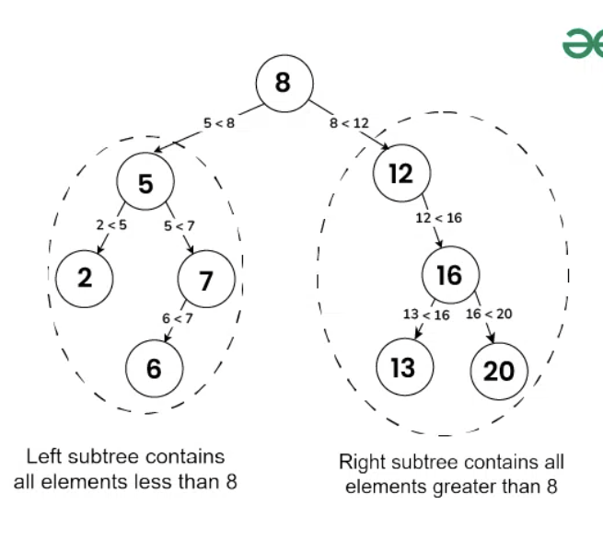


SAR ADC Working
Binary search algorithm : The fundamental operational principle of SAR (Successive Approximation Register) ADCs hinges upon the binary search algorithm, an iterative technique employed to progressively narrow down the feasible range within which the analog input value resides.

Slide 7
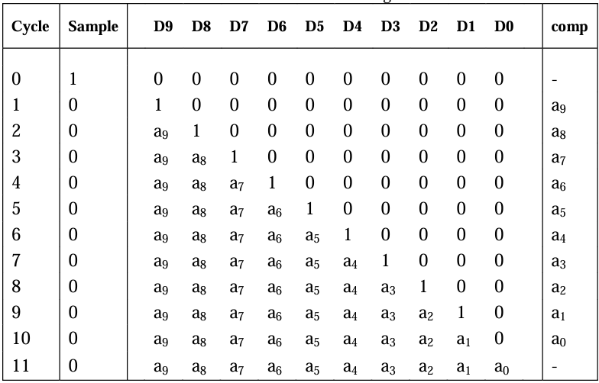
SAR Logic Operation

Slide 8
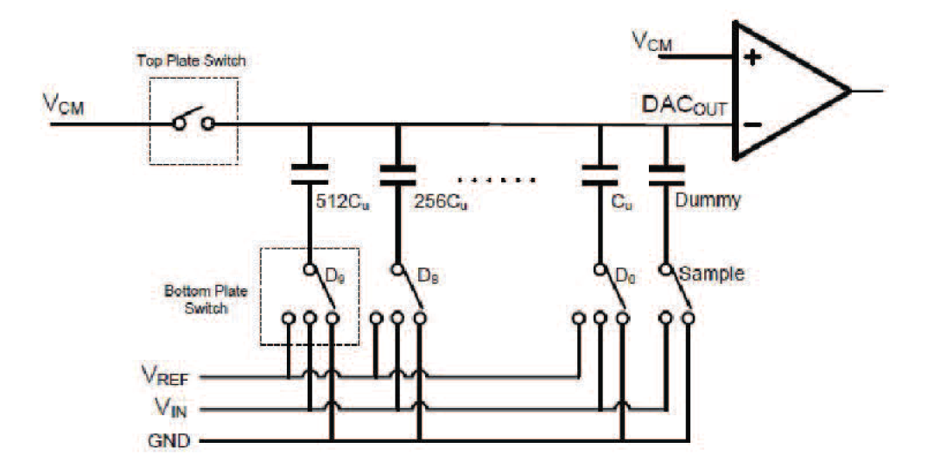
2) Conversion cycle : The SAR ADC conversion cycle encapsulates the process of transforming an analog input into a corresponding digital output. The cycle unfolds with the initiation of sampling, during which the input voltage is captured and stabilized by the Sample and Hold Circuit.

Slide 9




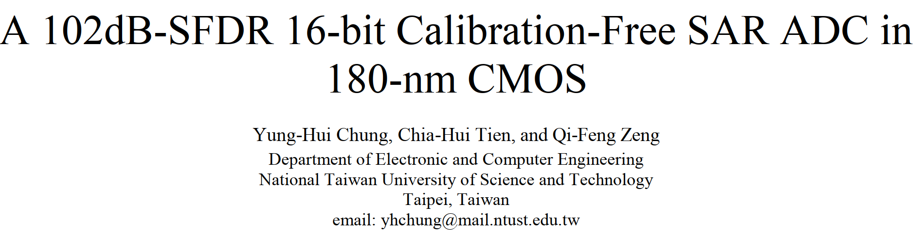
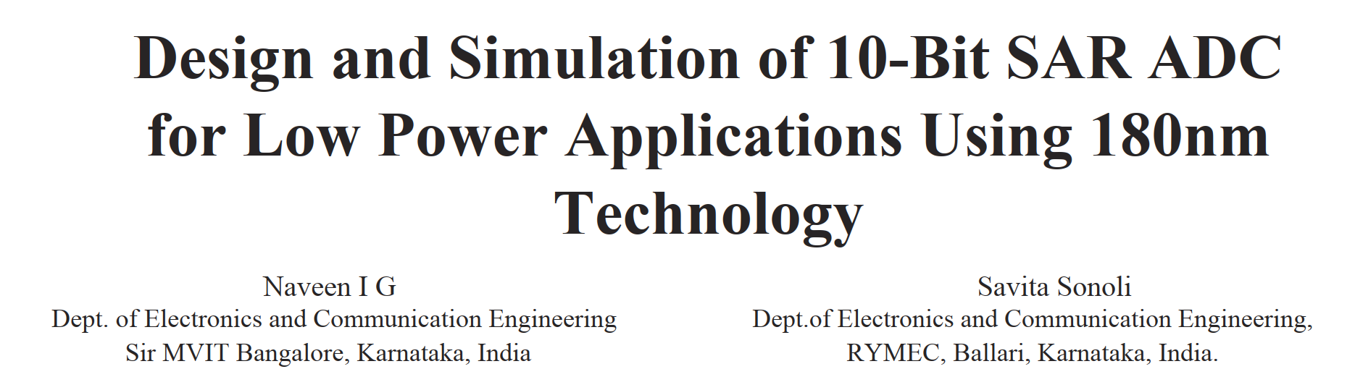

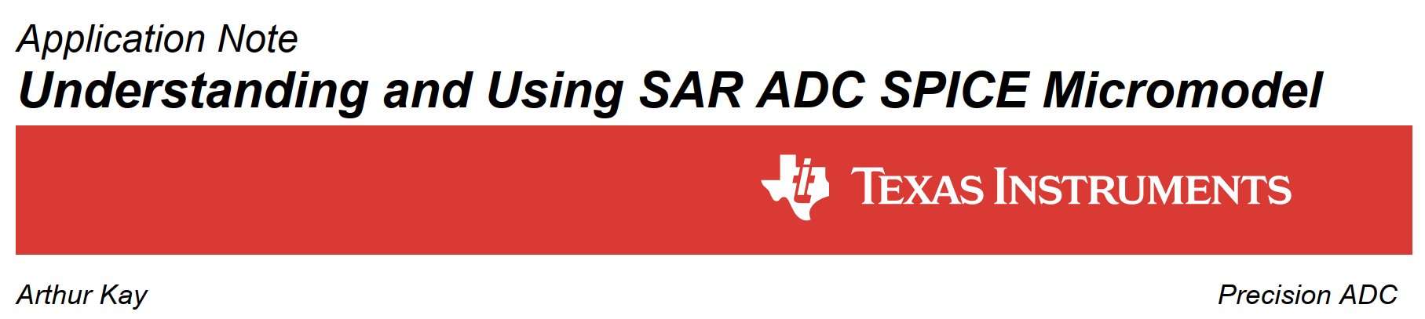

Slide 10

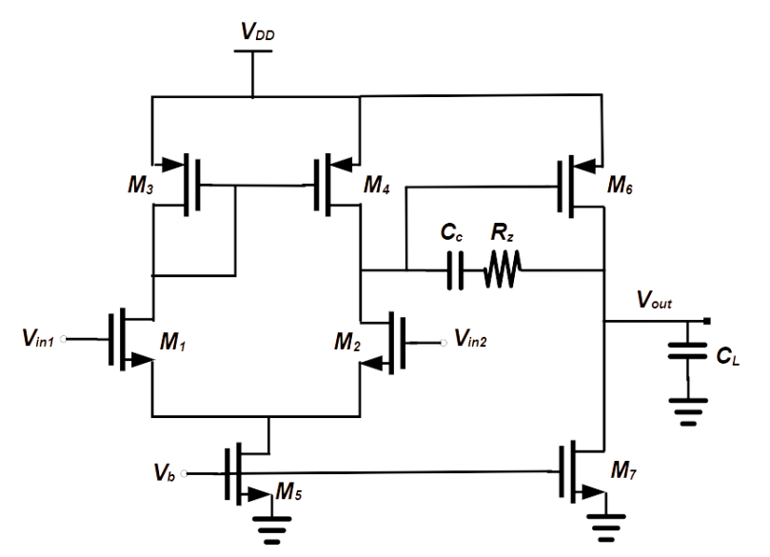
The idea and Functional Blocks
Functional Blocks :
1) Comparator :

Slide 11
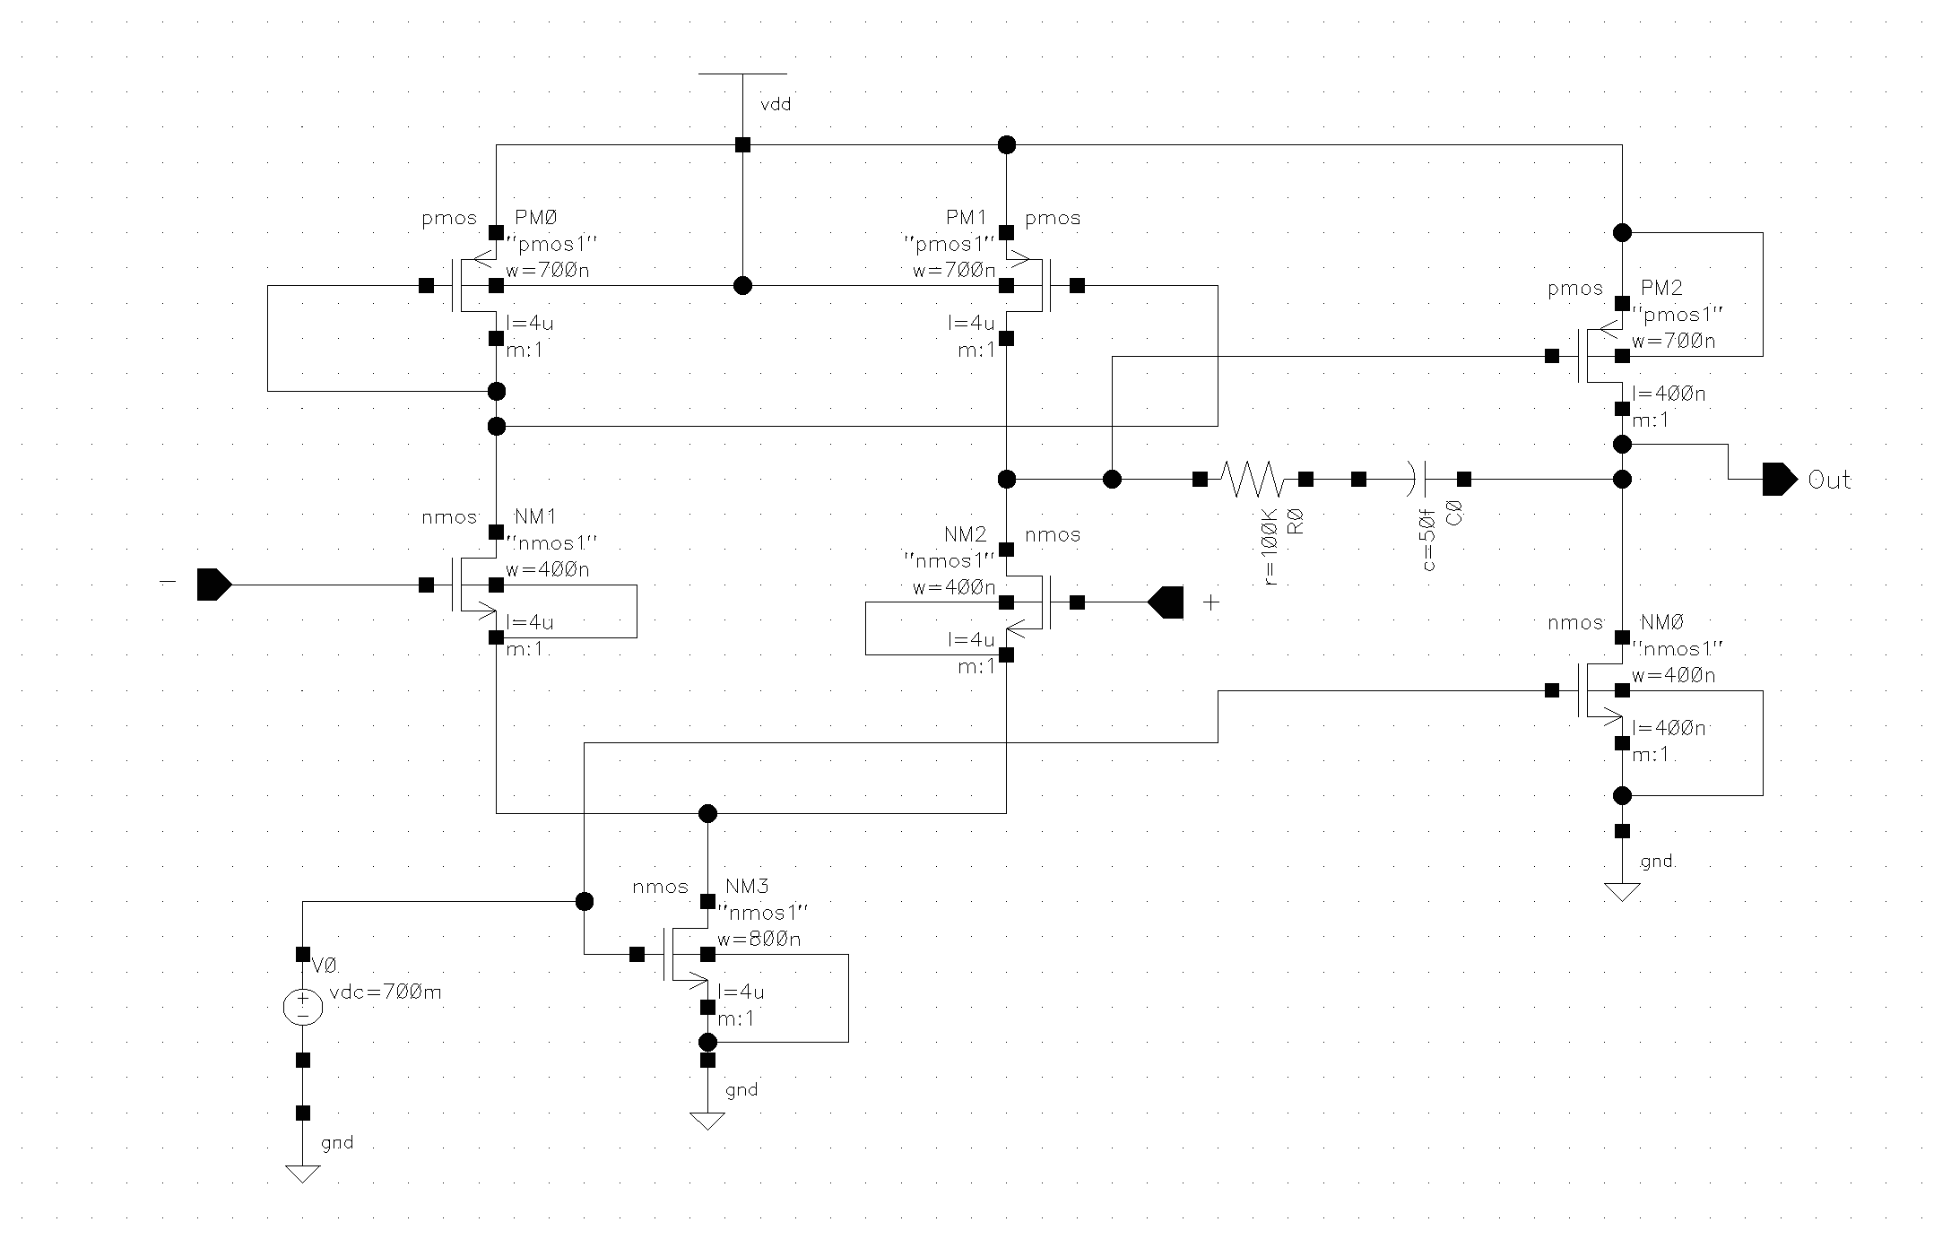
Two stage Op-amp schematic

Slide 12
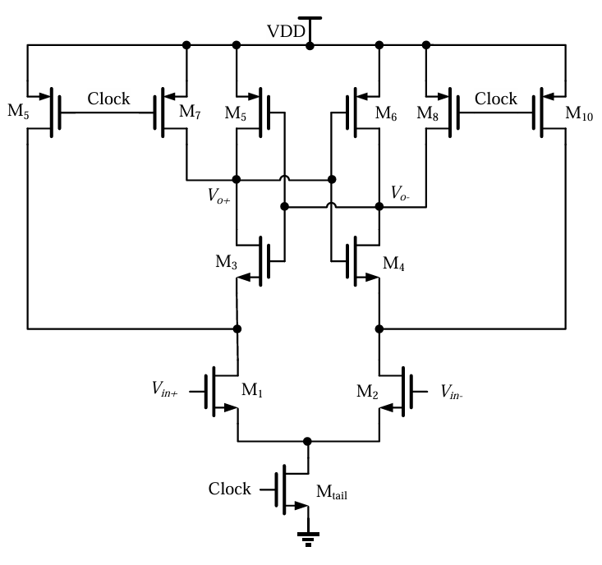
Dynamic comparator

Slide 13
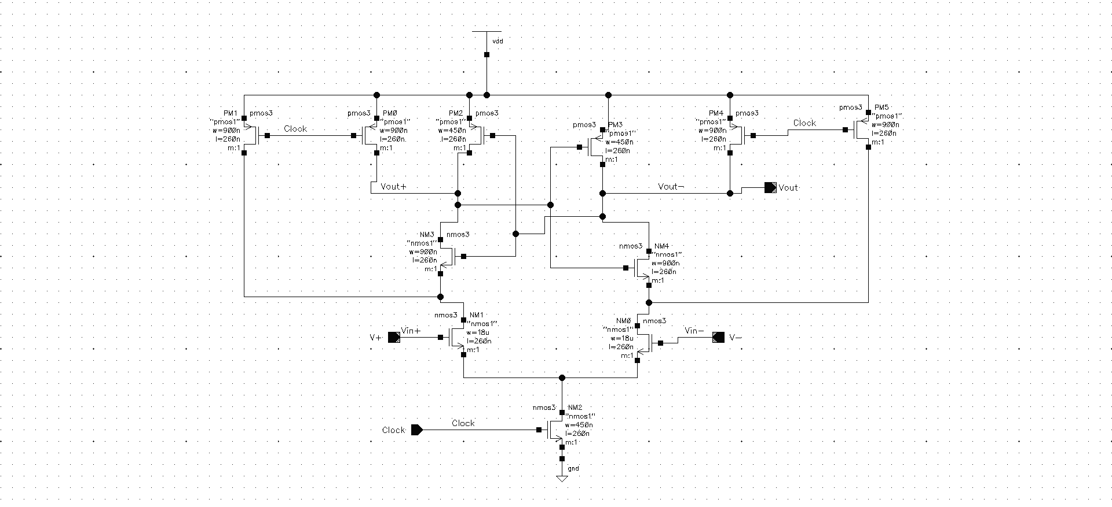
Dynamic Comparator schematic

Slide 14
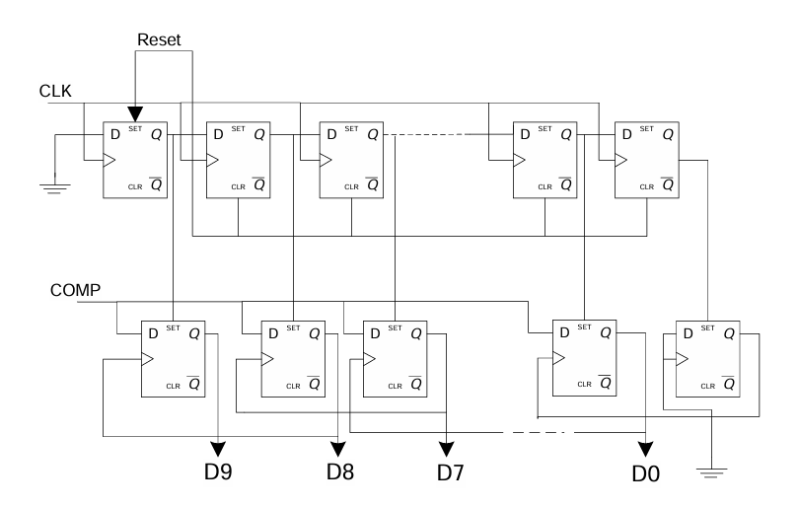
SAR Logic Block

Slide 15
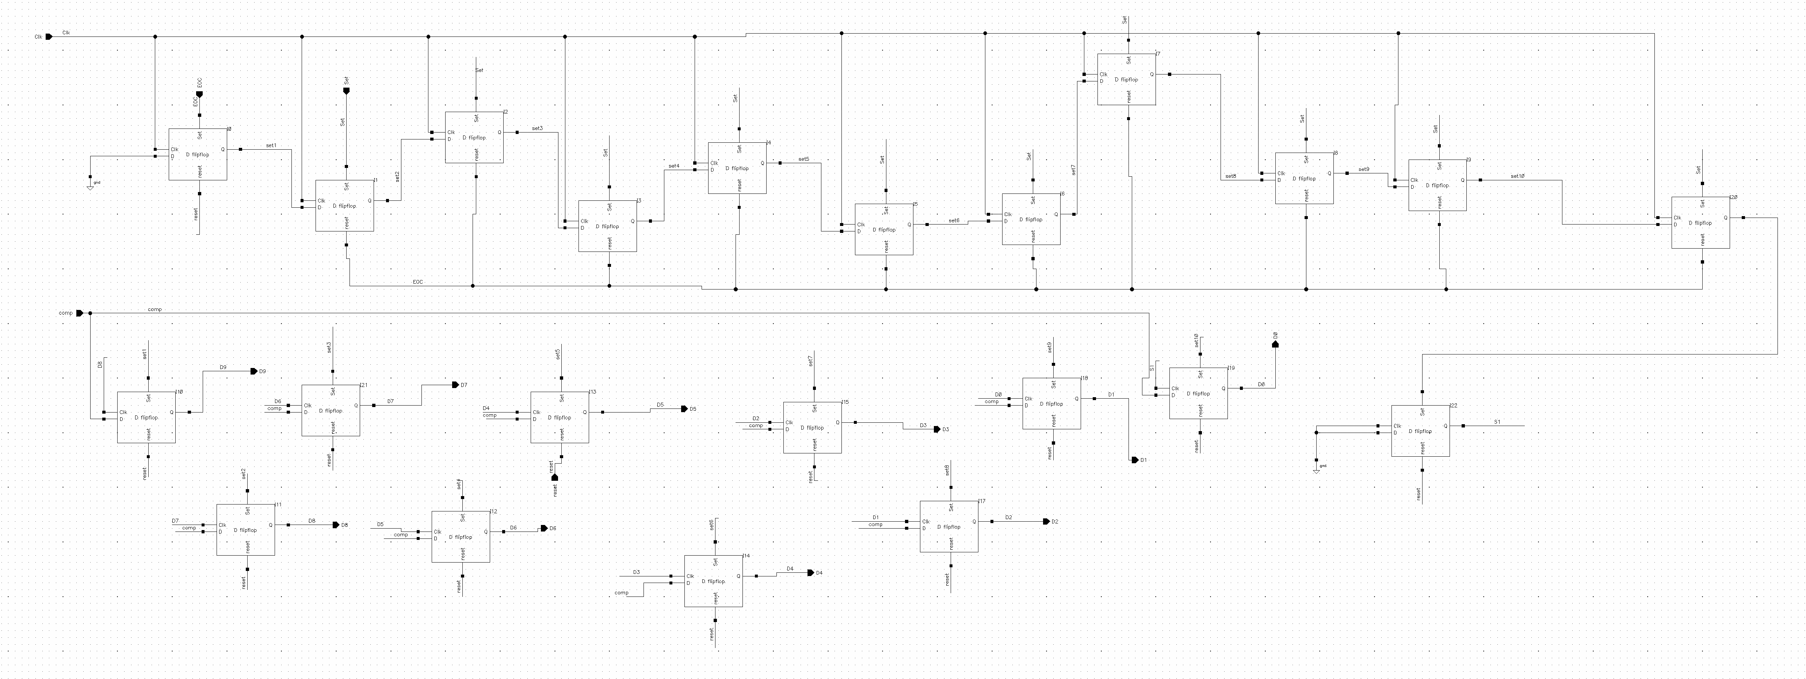
Block we designed

Slide 16
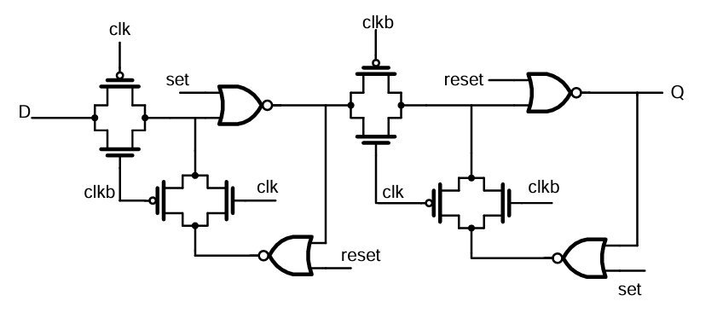
D-Flipflop used in the design

Slide 17
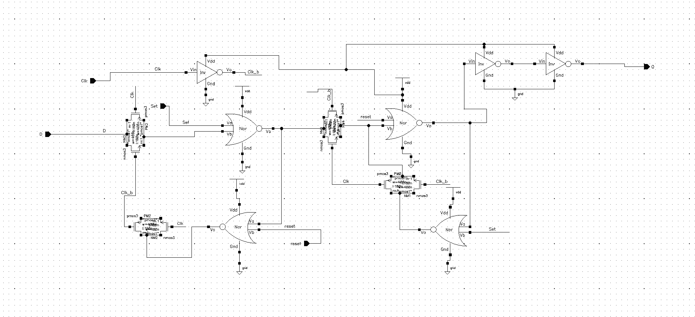
D-Flipflop

Slide 18
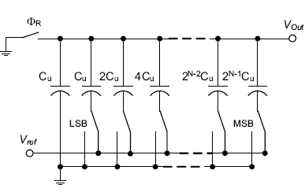
DAC

Slide 19
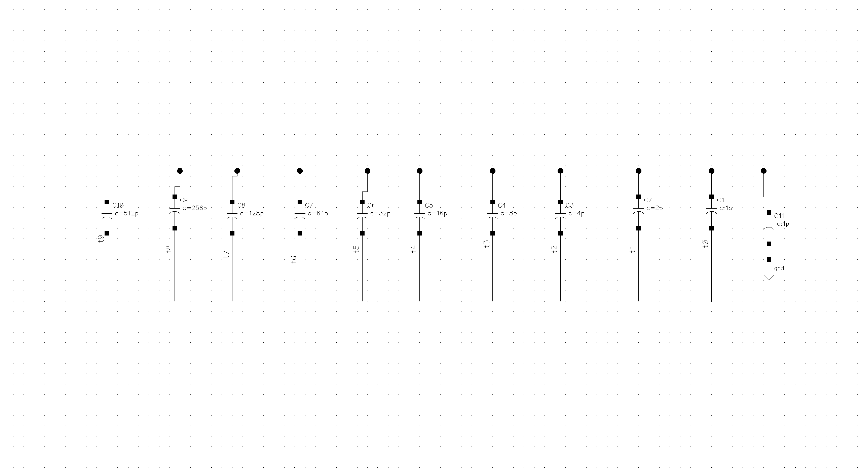
DAC

Slide 20
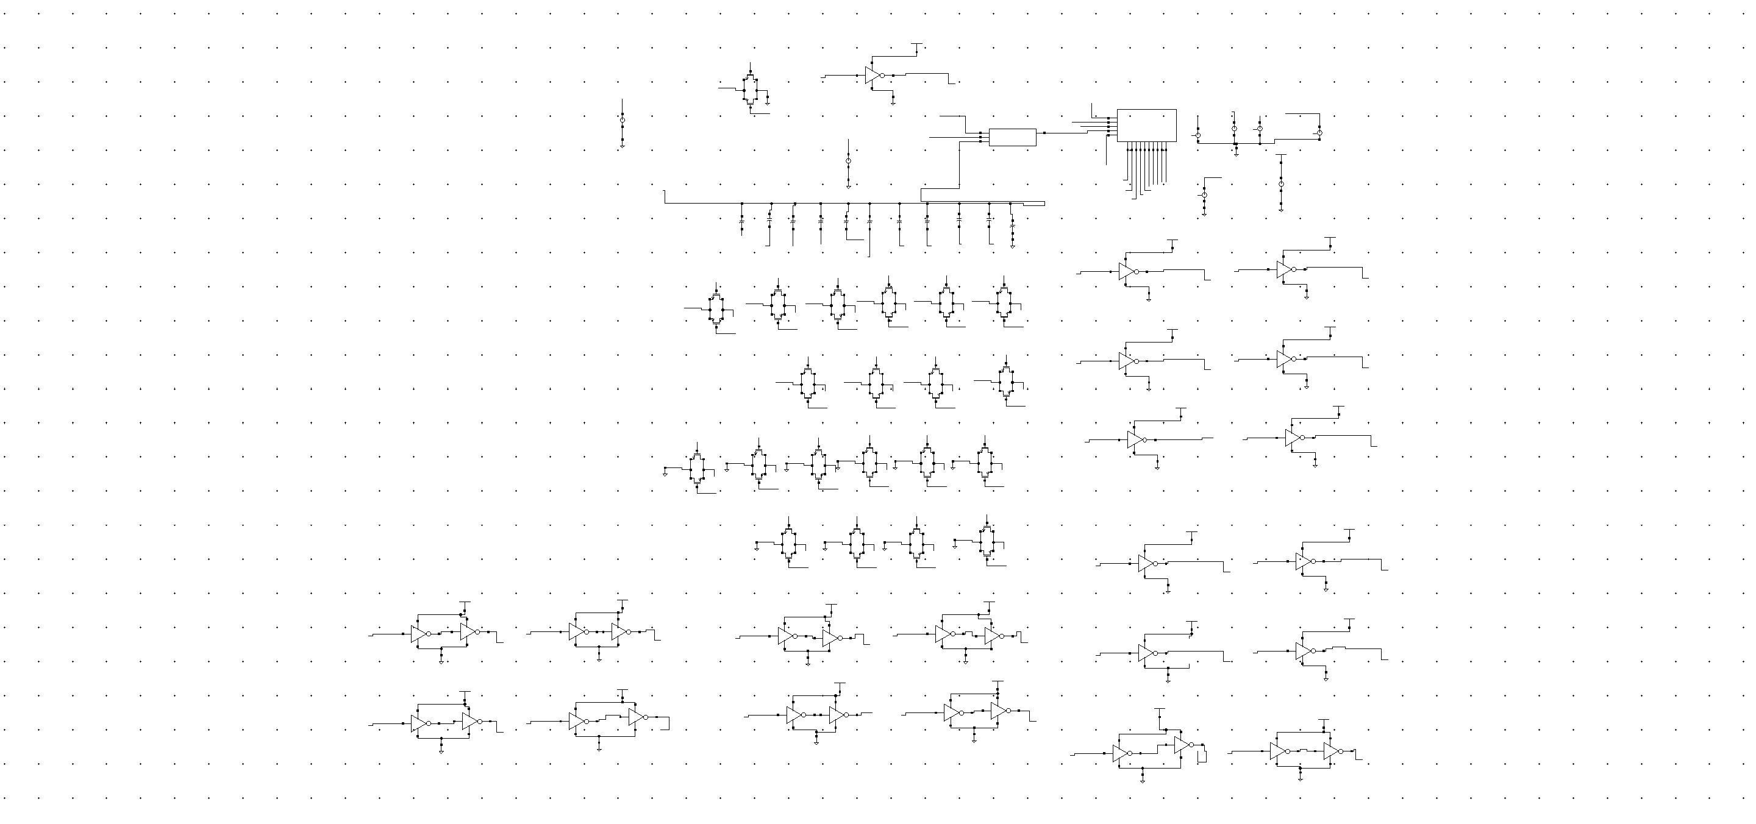
Schematic

Slide 21
Challenges Faced:
Transition of output at exact positive edge of clock.
Pre-charge of capacitors before 1st positive edge of clock.
Circuit complexity increased after using back gate capacitor.
Need for different clocks delays.

Slide 22
Resolutions :
Used dynamic comparator instead of two stage op-amp to control when to take output.
Used reset signal to discharge the capacitor to ground before start of operation.
Replaced back gate capacitor type DAC by keeping a customized DAC block.
Required clock delays were given to different components.

Slide 23
Final Results:
Speed 0.1MHz
Power Consumption 123.8 uW
Throughput 1bit/1u sec
Latency 10 clock pulses
Error 3-7%

Slide 24
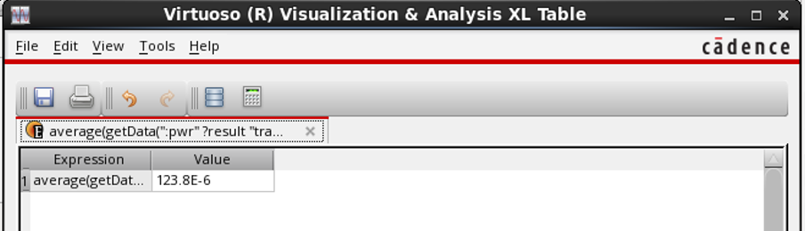
Average power :

Slide 25
S.No | Practical Analog i/p Voltage (V) | Digital Code Obtained O/P | Theoretical Analog Voltage (V)
1 | 1.4 | 1101000100 | 1.46
2 | 1.169 | 1010111100 | 1.23
3 | 0.7 | 0110011001 | 0.718
4 | 1.02 | 1001101100 | 1.089
5 | 0.42 | 01000000000 | 0.449

Slide 26
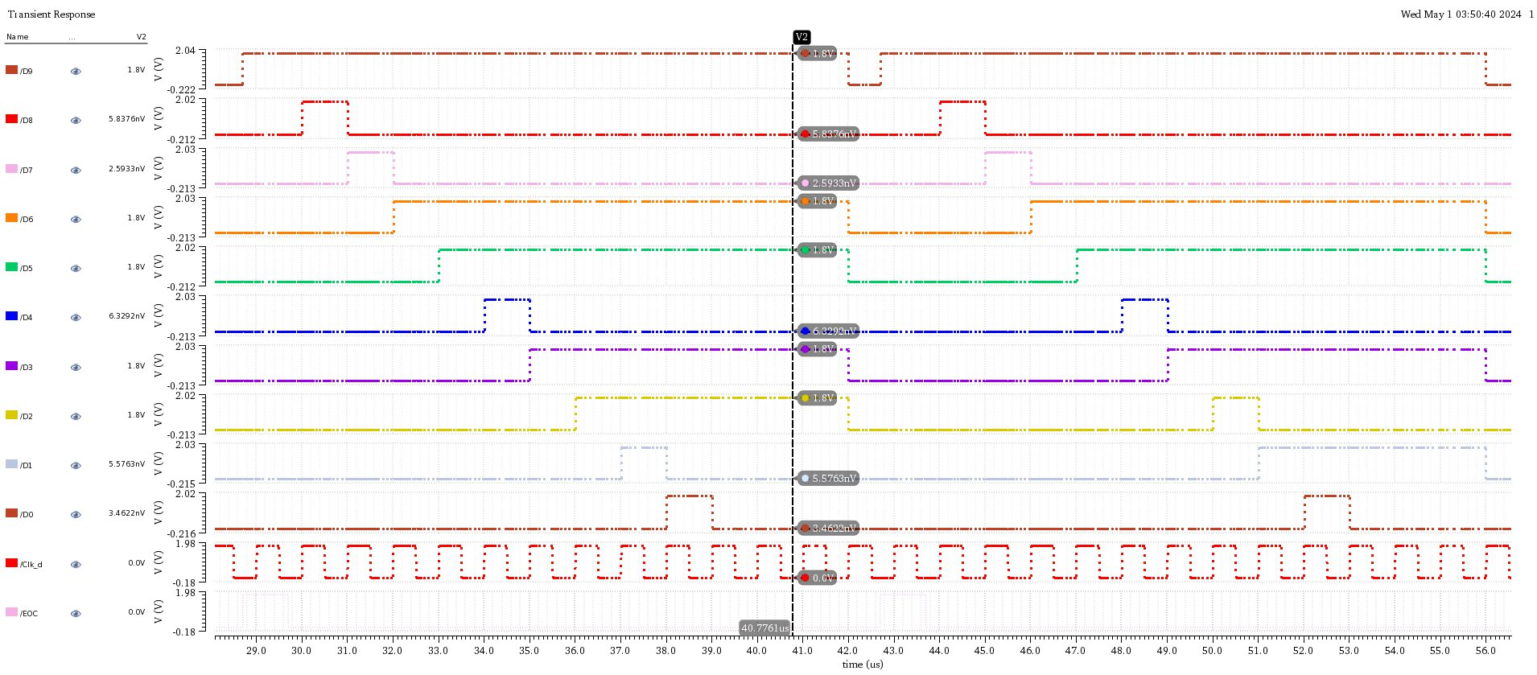
For 1.02 Volts:

Slide 27
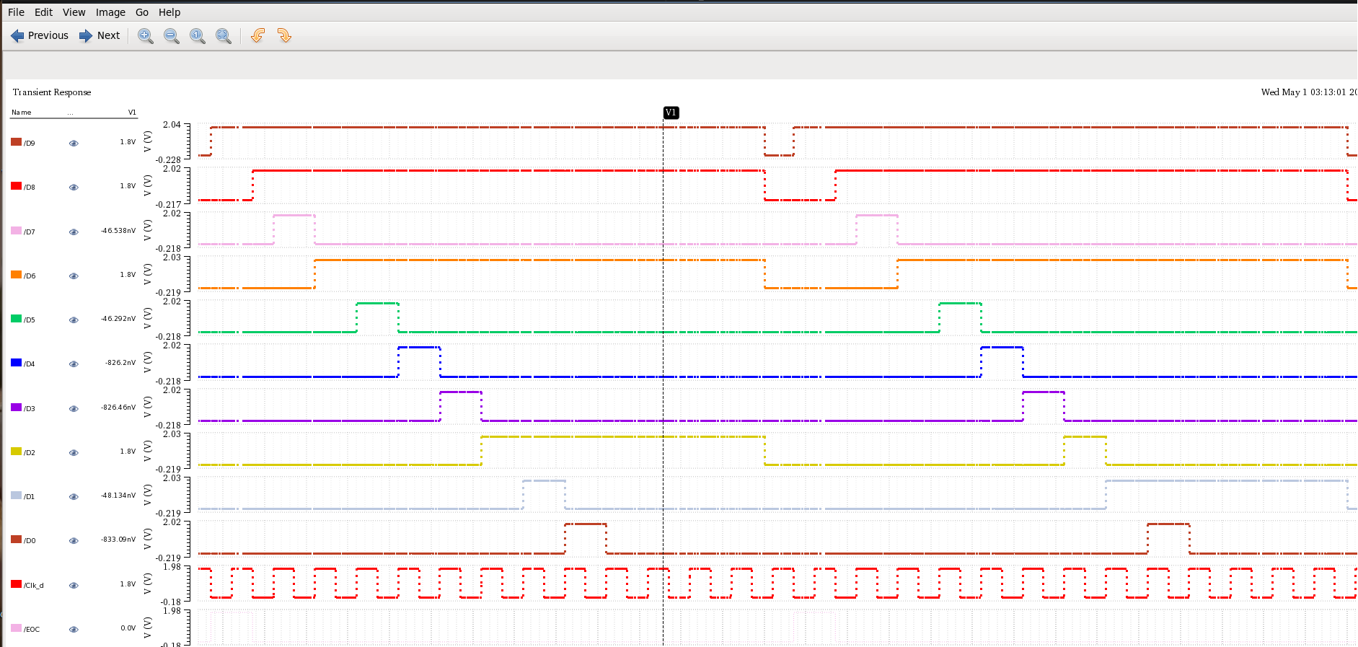
For 1.4 Volts:

Slide 28
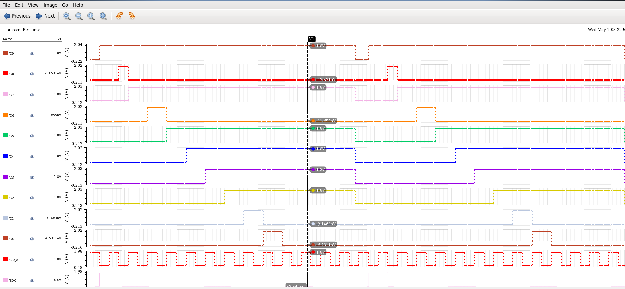
For 1.169 Volts:

Slide 29
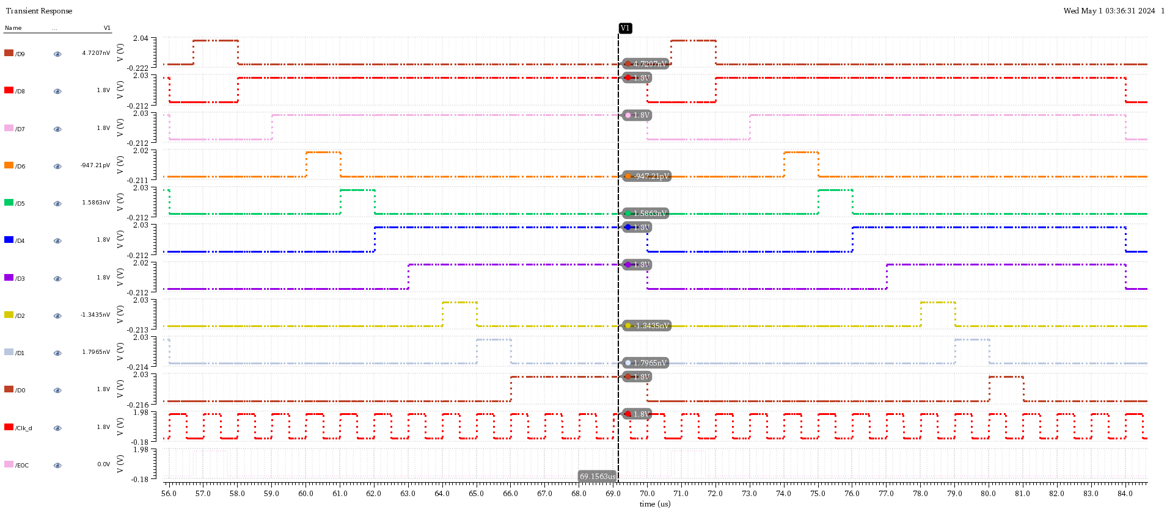
For 0.7 Volts:

Slide 30
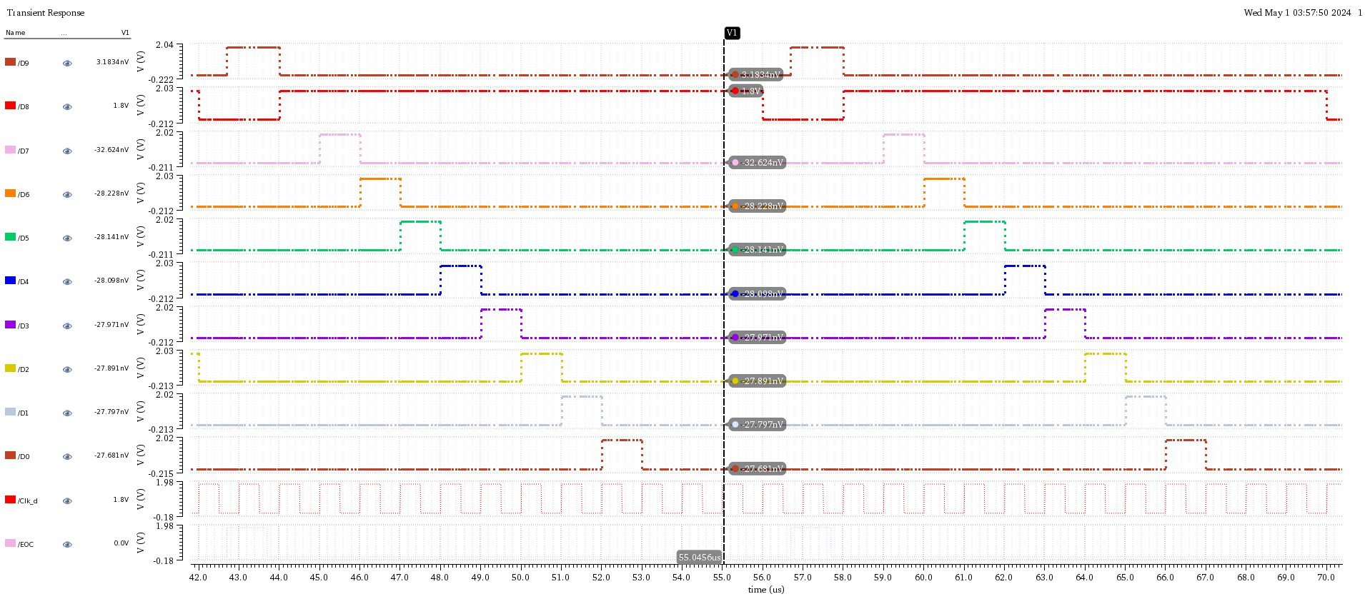
For 0.42 Volts:

Slide 31
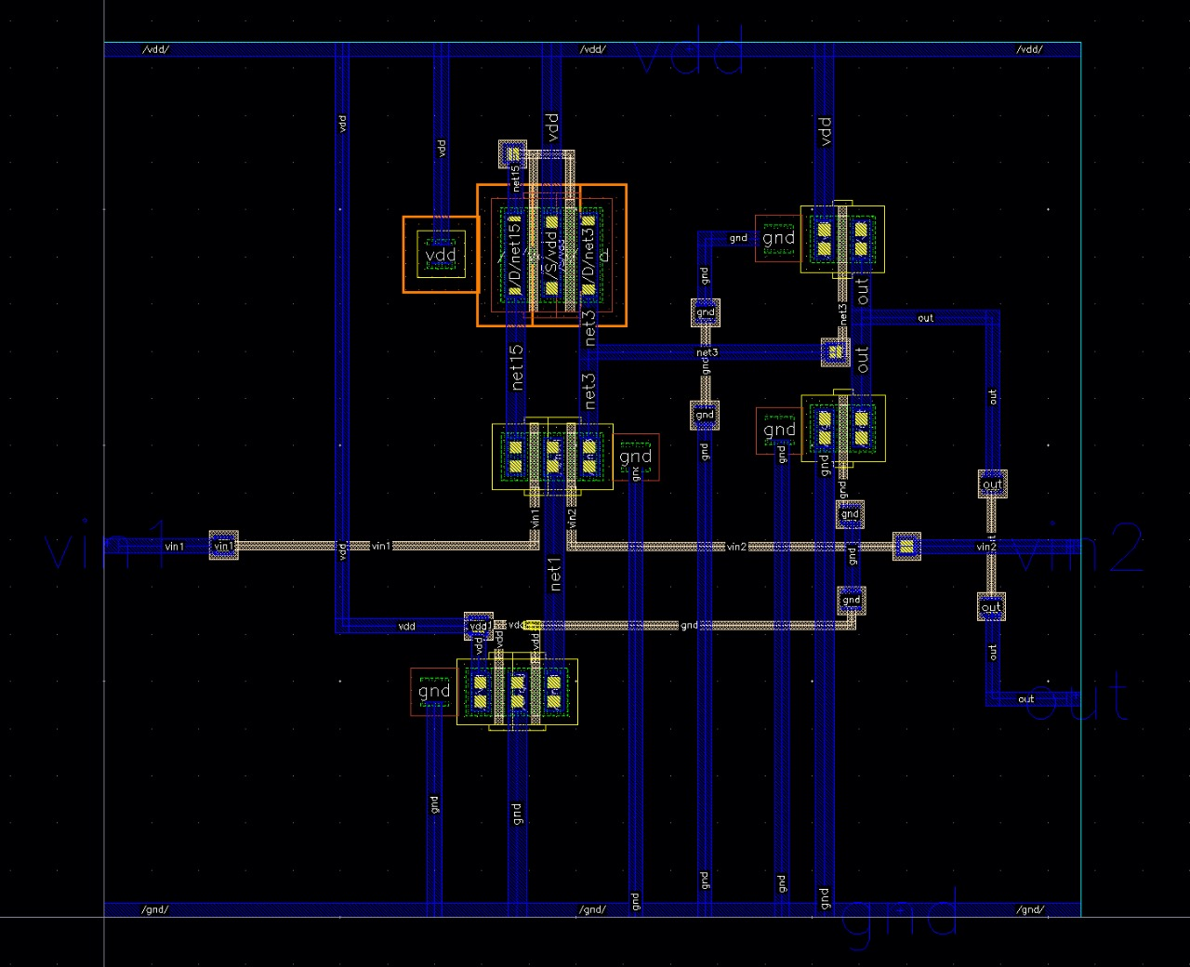
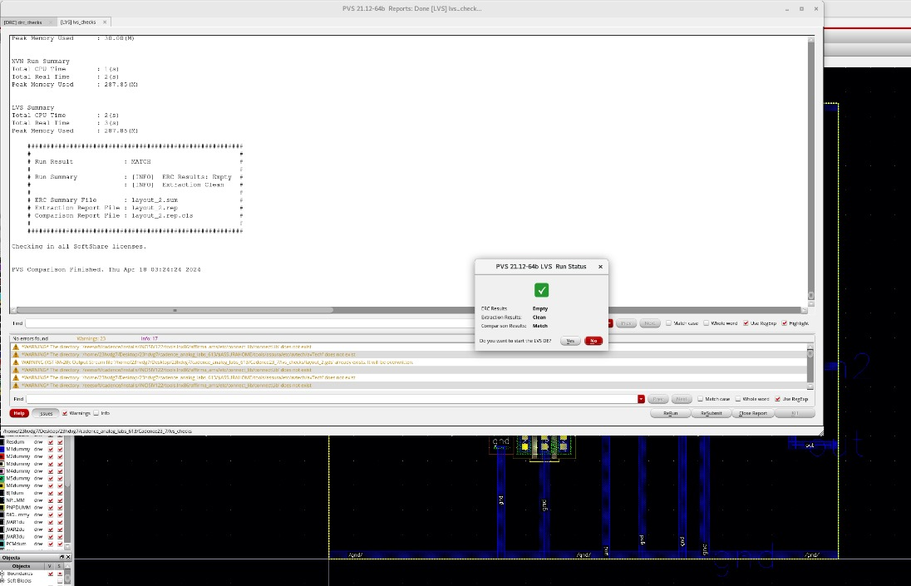
Two stage Op-amp Layout

Slide 32
Applications:
1. Electrocardiogram (ECG) Monitoring: SAR ADCs are commonly used in ECG monitors to convert the analog voltage signal from electrodes attached to the patient's body into digital data for analysis.
2. Electroencephalography (EEG) Systems: EEG systems record brainwave signals, which are typically very weak and require high-resolution ADCs for accurate measurement.
3. Blood Glucose Monitors: Continuous glucose monitoring systems rely on accurate ADCs to convert the analog signal from glucose sensors into digital data for real-time monitoring of blood glucose levels in diabetic patients.
4. Medical Imaging : SAR ADCs are employed in various medical imaging modalities such as MRI (Magnetic Resonance Imaging), CT (Computed Tomography), and ultrasound systems.
5. Implantable Medical Devices: SAR ADCs are suitable for implantable medical devices such as pacemakers, defibrillators, and neurostimulators
6. Biopotential Measurements: SAR ADCs are used in the acquisition of biopotential signals such as electromyography (EMG), electrooculography (EOG), and electroretinography (ERG).

